Slide 1
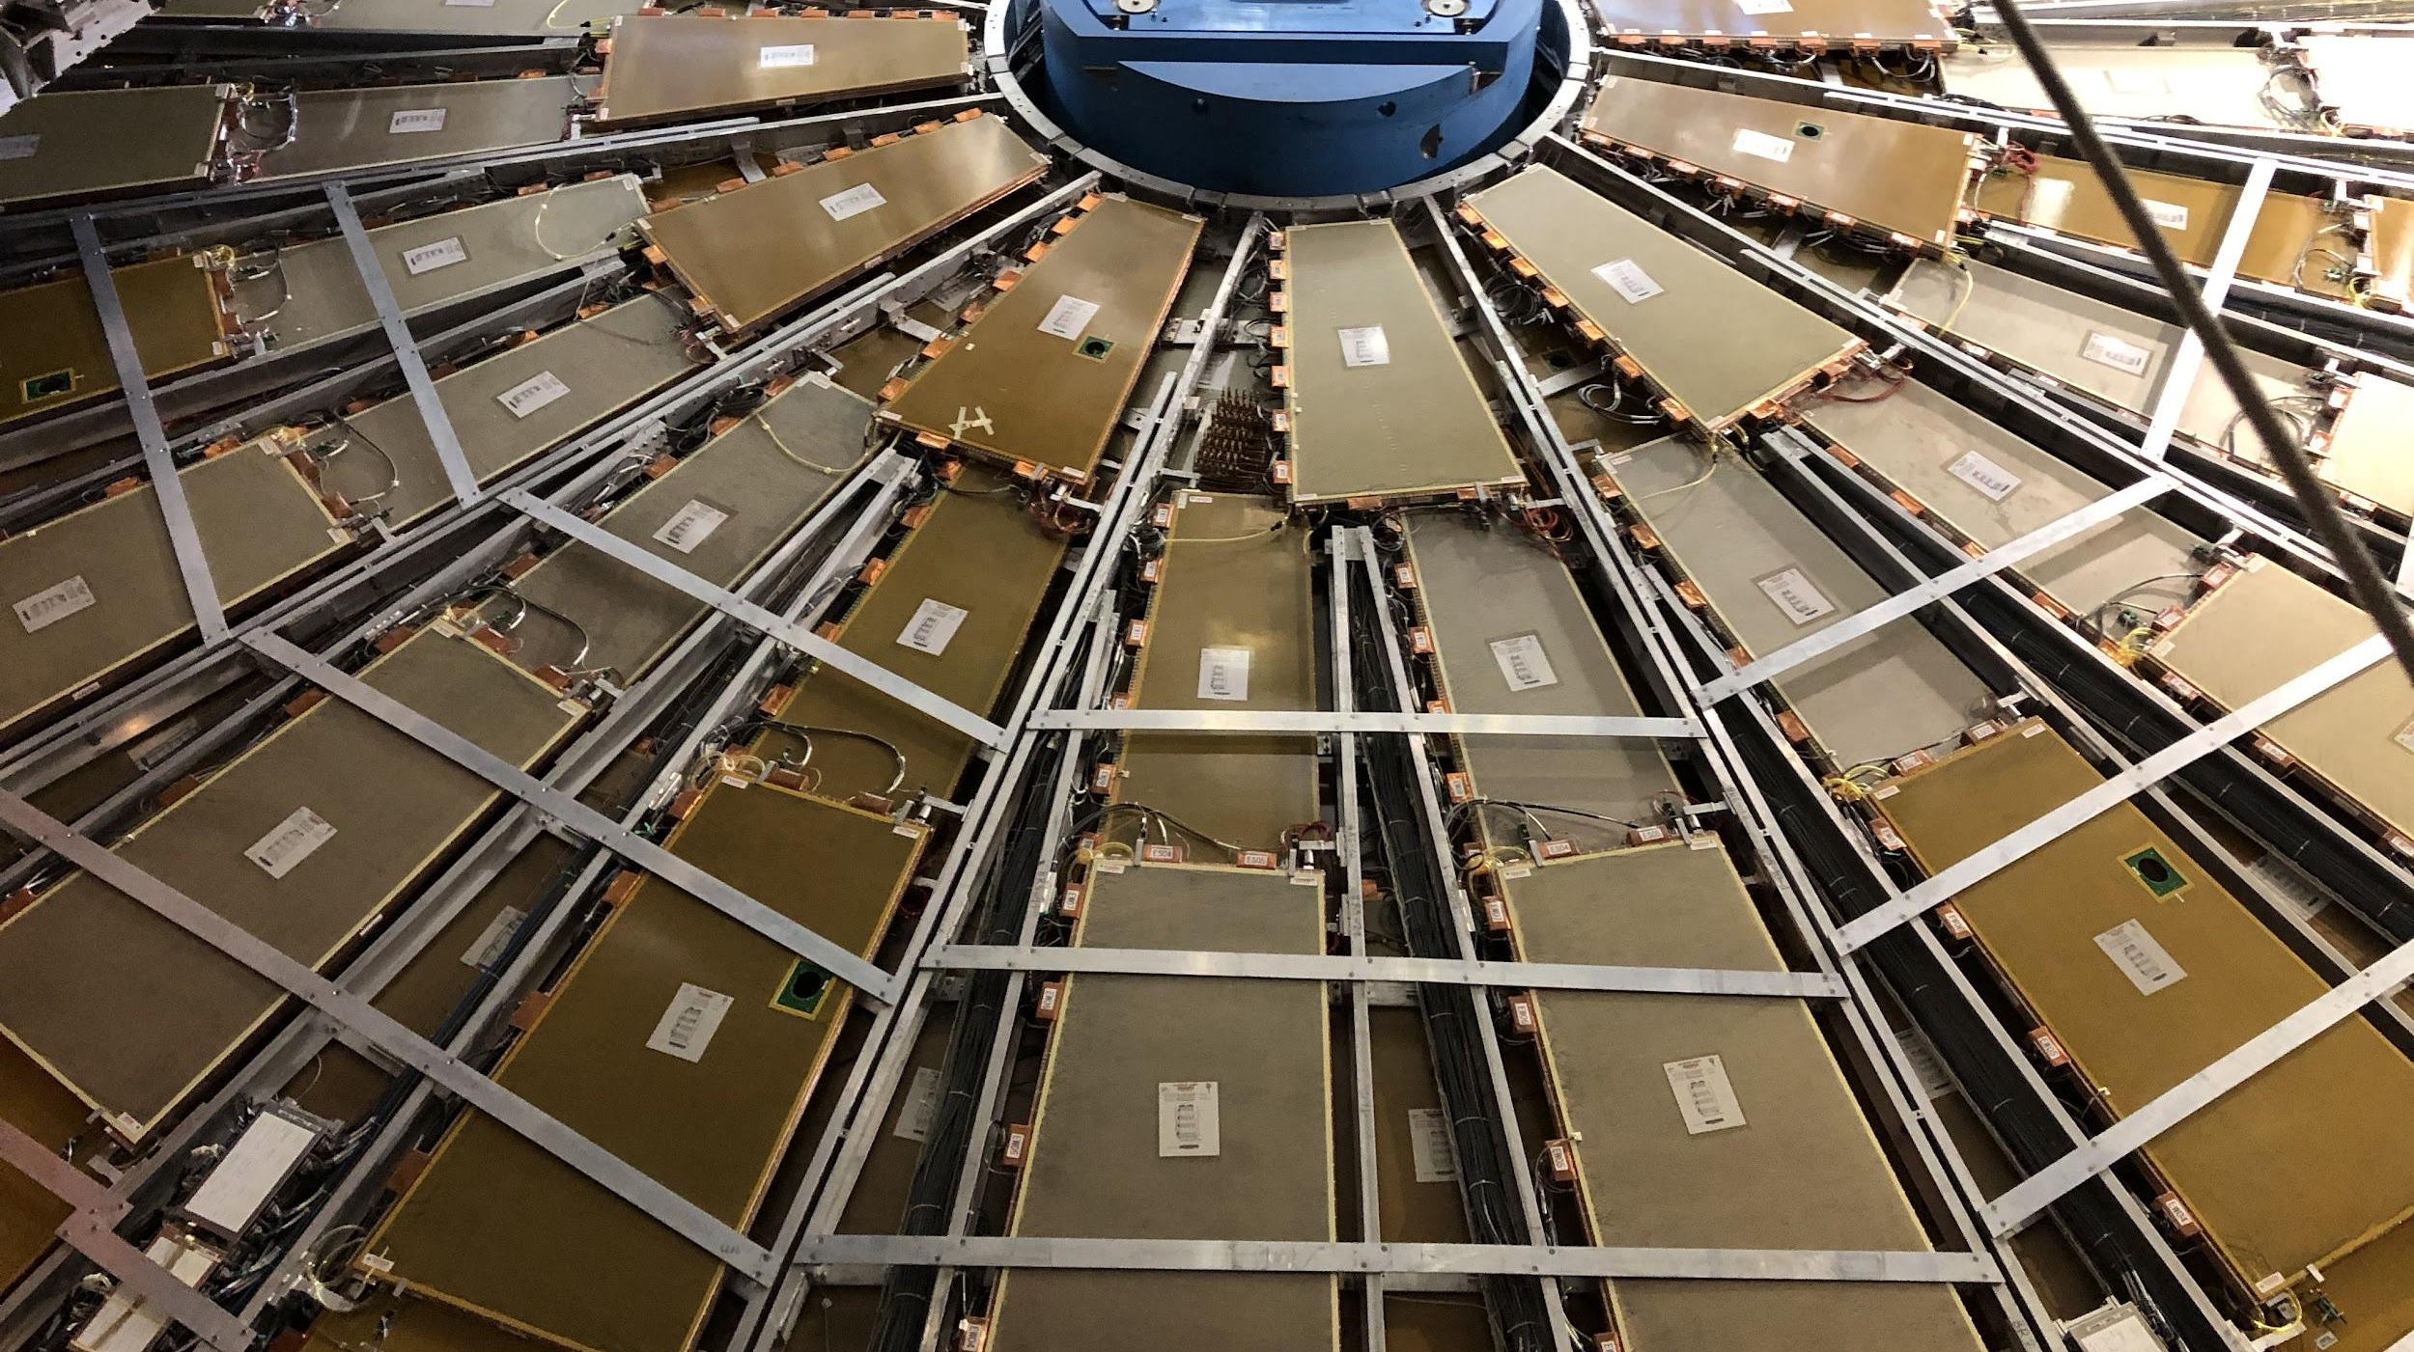


CIS Tech Update
Chicago Meeting, August 15th, 2022
Peter Camporeale and Jacky Li

Slide 2
Outline
CIS Constant Updates
Summary of CIS
June 23 – July 14
July 15 – August 9
Performance
Low Voltage Power Supply / Detector Control System Monitoring
L1 Trigger System
Fast Calo Simulation
Test Beam
ATLAS Control Room Shifts
Life

Slide 3
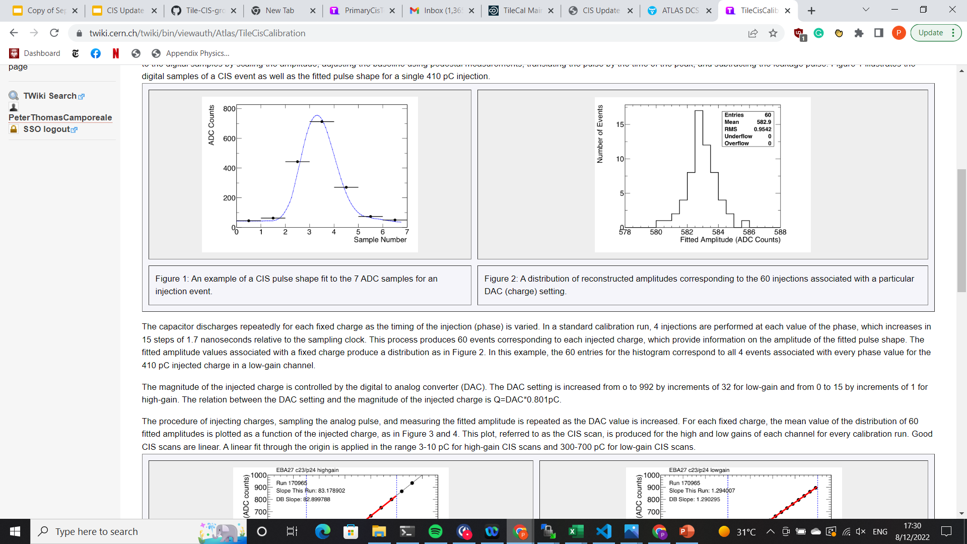
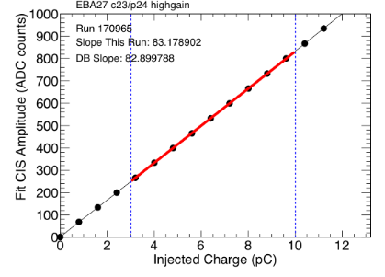
1.a. Summary of CIS
Use known input charge to calibrate ADC counts of front-end electronics
3-in-1 cards contain 5,100 pF capacitors
Input known charge 60 times, sample each pulse 7 times → pulse amplitude
Fit mean pulse amplitude (in ADC counts) to injected charge
CIS calibration runs are taken between ATLAS runs, roughly 3 times per week
Use TUCS to analyze data for recent runs and identify DQ issues in channels
Monitor individual channels: drifting, high scatter, half-gain?
Monitor overall performance: percent change, long-term stability, RMS/mean
Upload new constants to database

Slide 4
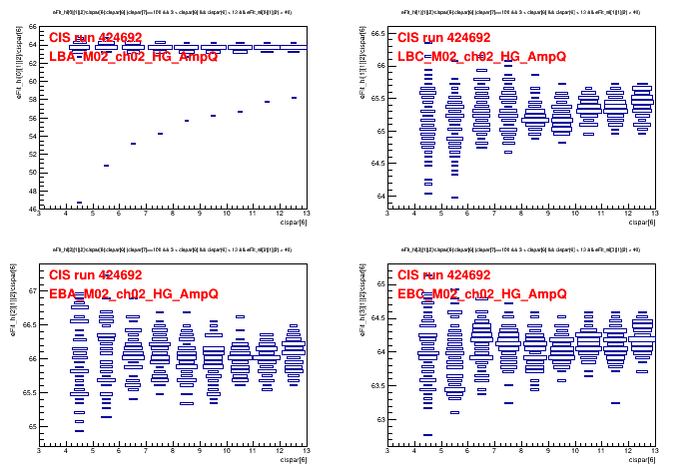
1.b. CIS Constant Update: June 23-July 14
Transition from last generation of Katie and Dawit to Peter and Jacky
163 Channels in update
Many timing changes in the middle of June caused bad runs (see Amplitude-Charge ratio plots). Visible as step function in plots of constant for each module
Took runs instead from near the end of June for better statistics

Slide 5
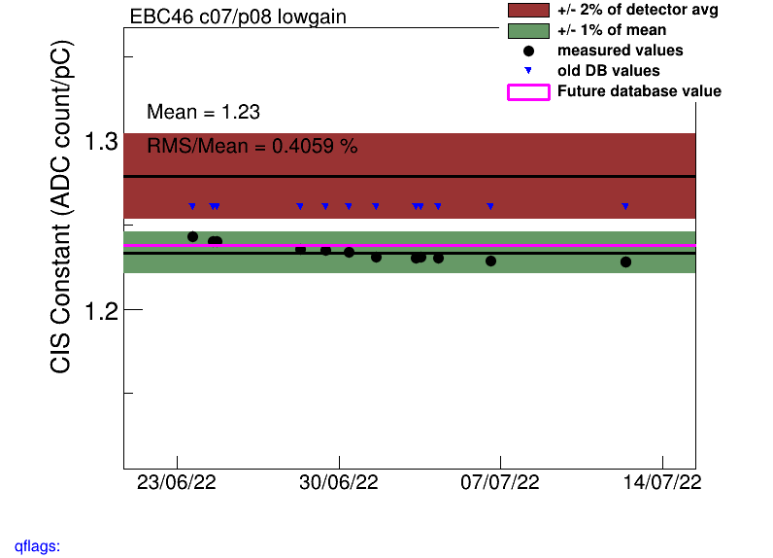
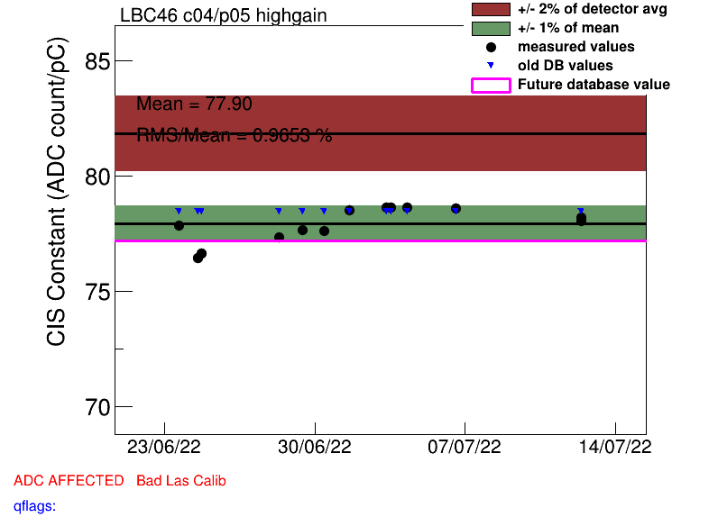
1.b. CIS Constant Update: June 23-July 14
Drifting channel, marked as bad CIS
High-scatter channel, marked as bad CIS

Slide 6
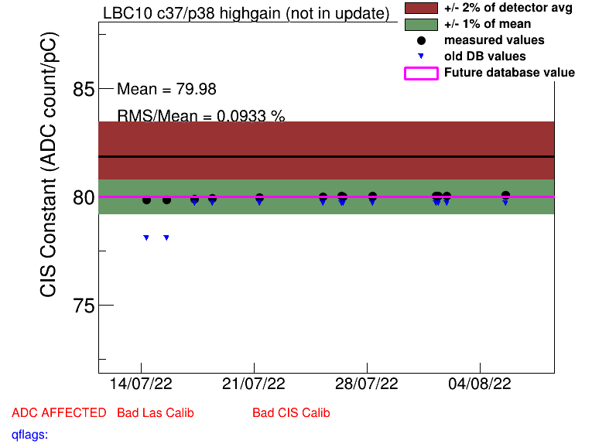
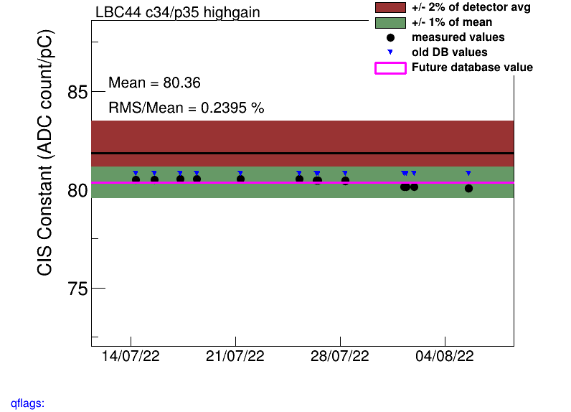
1.c. CIS Constant Update: July 14 – August 8
We presented these results at the Thursday Tile Maintenance meeting. Database will be updated by Tuesday.
Only 26 channels in update

Slide 7
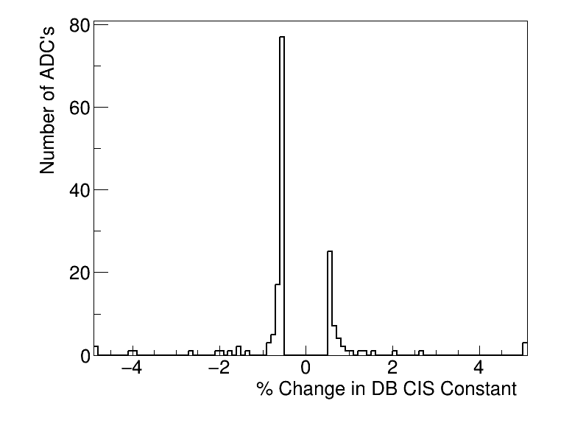
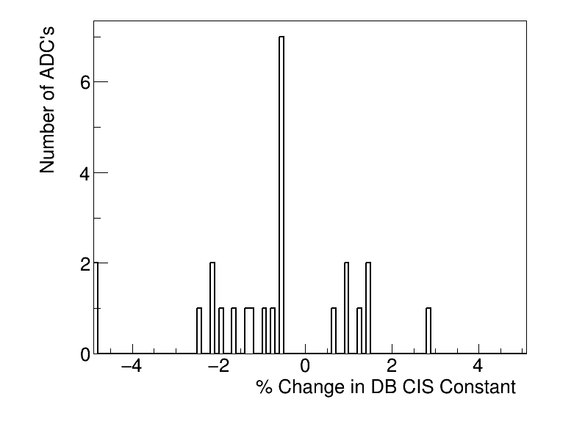
1.d. Performance: DB % Change
% change in database values, June 23 – July 14 (163 channels)
% change in database values, July 14 – August 8 (25 channels)

Slide 8
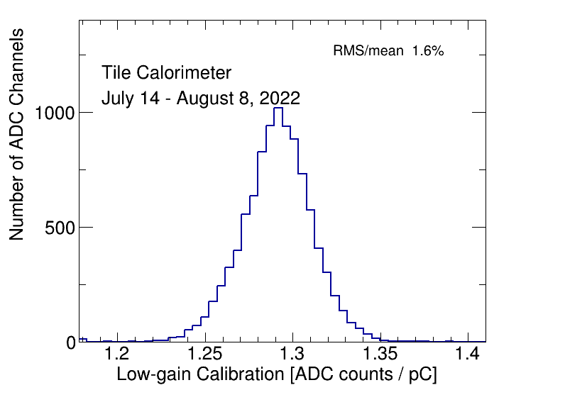
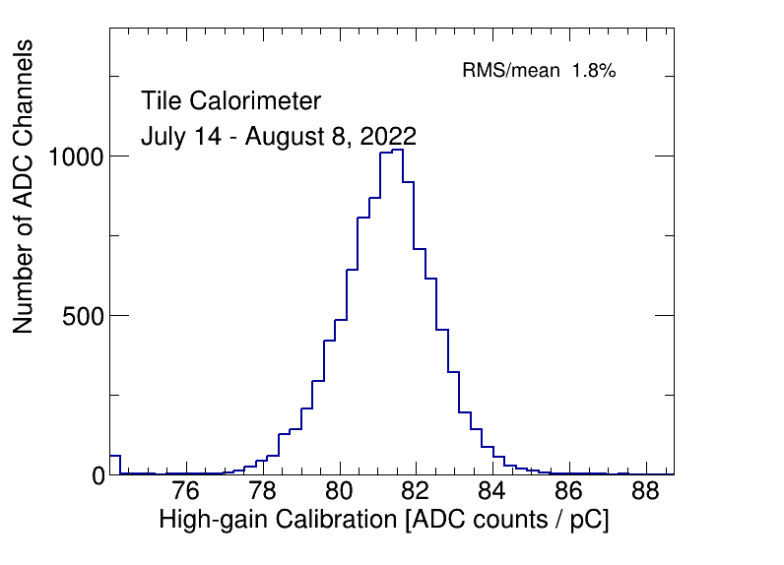
1.d. Performance: Distribution by Channel
Example: July 14- August 8

Slide 9
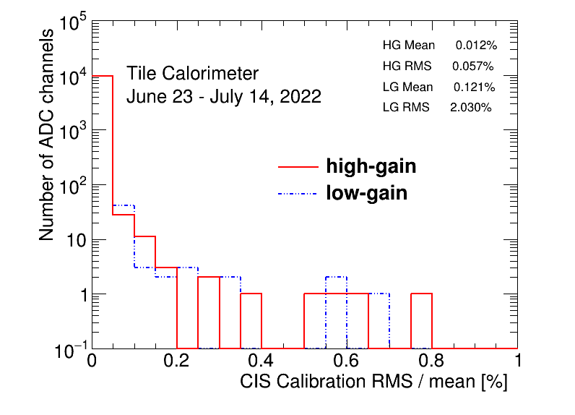
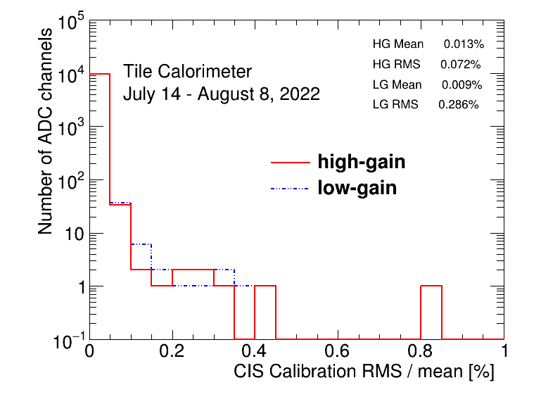
1.d. Performance: RMS/Mean

Slide 10
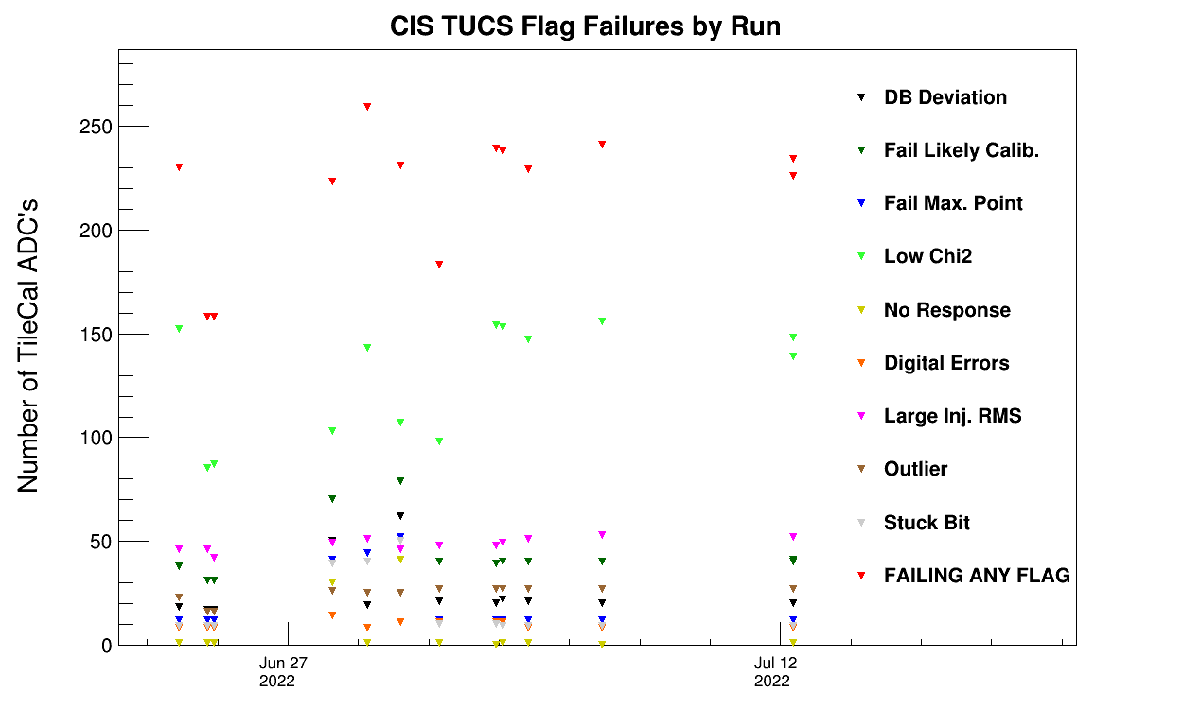
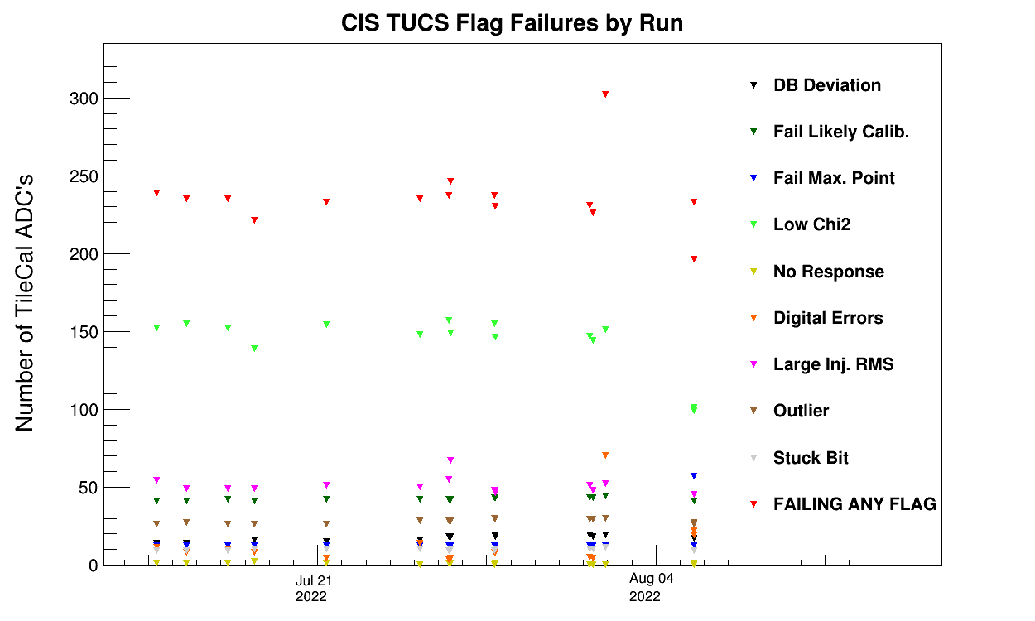
1.d. Performance: TUCS Quality Flags
TUCS Quality Flags, June 23 – July 14 (163 channels)
TUCS Quality Flags, July 15 – August 8 (25 channels)

Slide 11
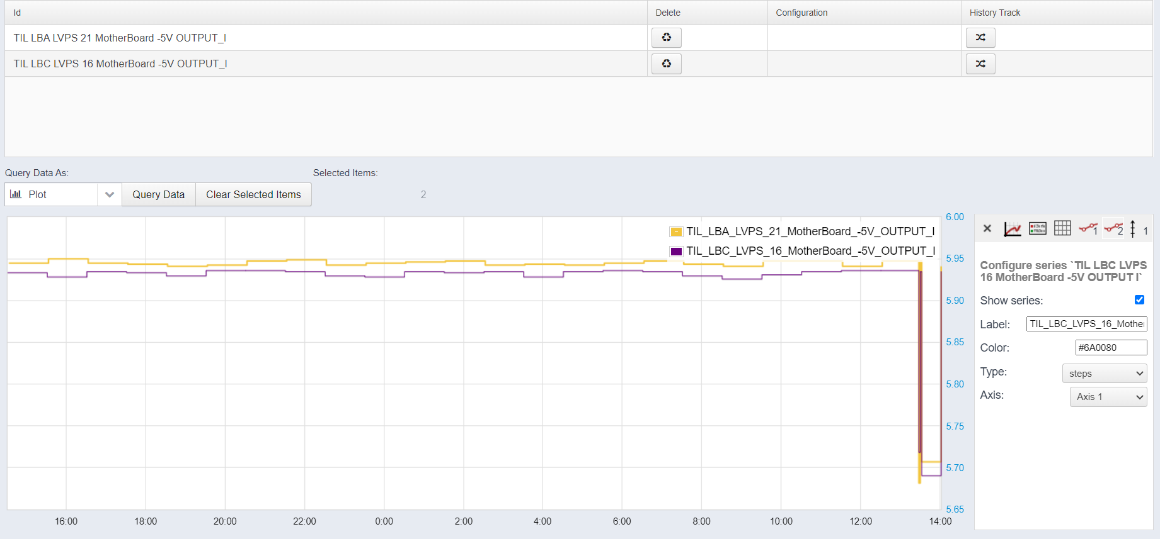
2. LVPS/DCS Monitoring
Overview:
Monitoring the current supplied to 5V motherboards in Tile modules
Currently, there is an online database. We want to collect this data to monitor current trips and integrate it with current systems
DDV applies “smoothing” to DCS: it only updates if the current change is outside a given interval
Online DDV data/plotting

Slide 12
2. LVPS/DCS Monitoring
Done:
Connected with Felipe Martins
Generated code for accessing/checking DCS values
Became familiar with some legacy code
Added new functionalities: time-averaging of current
To do:
Integrate the code into TIO (online monitoring system)
Connect with Sergei Chekalev

Slide 13
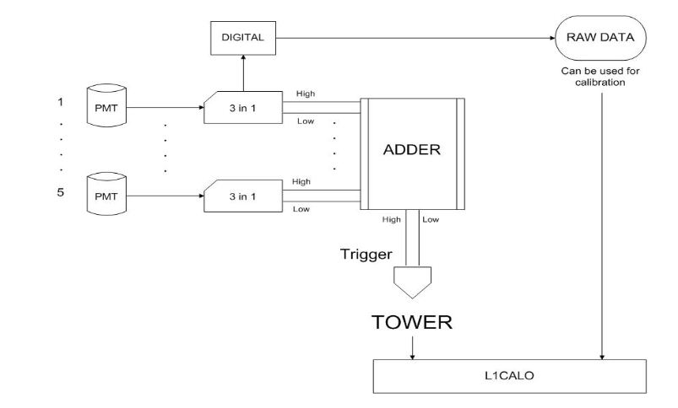

3. L1 Calo Trigger System
Connected with Danijela Bogavac
Overview of system:
Towers are collections of PMTs and front-end electronics that sum events covering $Δη×Δφ=0.1×0.1$ to produce trigger signals
Goals:
Monitoring of trigger rates in the L1 Calo
Integrate with Data Quality Monitoring Display (DQMD) in ACR
Analyze PMT scans to identify low trigger rates
Schematic of L1 calo tower

Slide 14
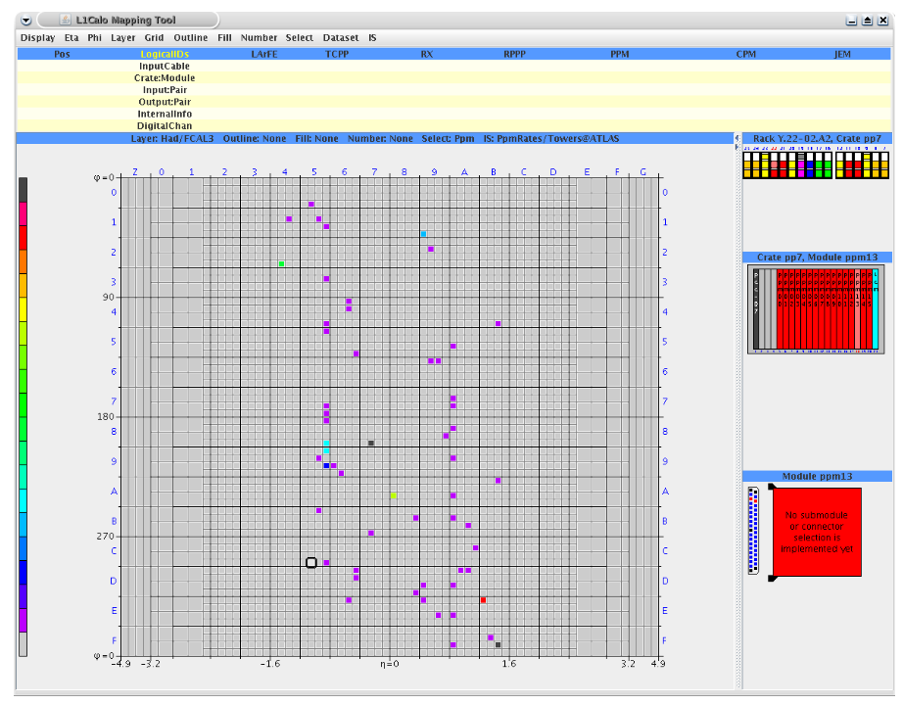
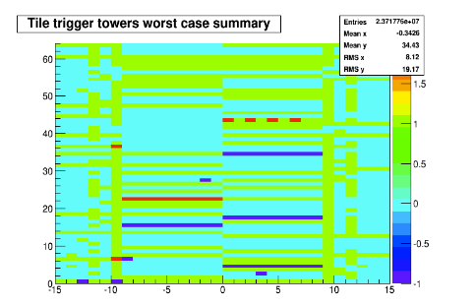
3. L1 Calo Trigger System
Done:
Reviewing code/documentation
Tour of ACR to see these systems in action
To do:
Meeting with Danijela again next week to commence project
Current L1 Calo Mapping Tool Data Quality Monitoring Display (DQMD)
Current L1 Calo Mapping Tool in Online Histogram Presenter (OHP)

Slide 15
4. Fast Calo Simulation (FCS)
Dawit explained his code and the goal of the simulations
Done:
Recreated plots
To do:
Connect with FCS group
None, until further notice.

Slide 16
5. Test Beam
Meeting with Irakli Minashvili
Done:
Checked the legacy Tile system in Test Beam.
Fixed Mobidick HV problem
To do:
Shift training before new test beam in November
None maintenance until further notice (Irakli is taking his vacation)

Slide 17
6. ATLAS Control Room Shifts
Peter’s first shifts were August 2 – August 8
Monitoring data quality for Tile modules
Reporting on LAr status and major problems
More shifts in late August and September
Jacky’s shift training is in late August, will take shifts next semester

Slide 18
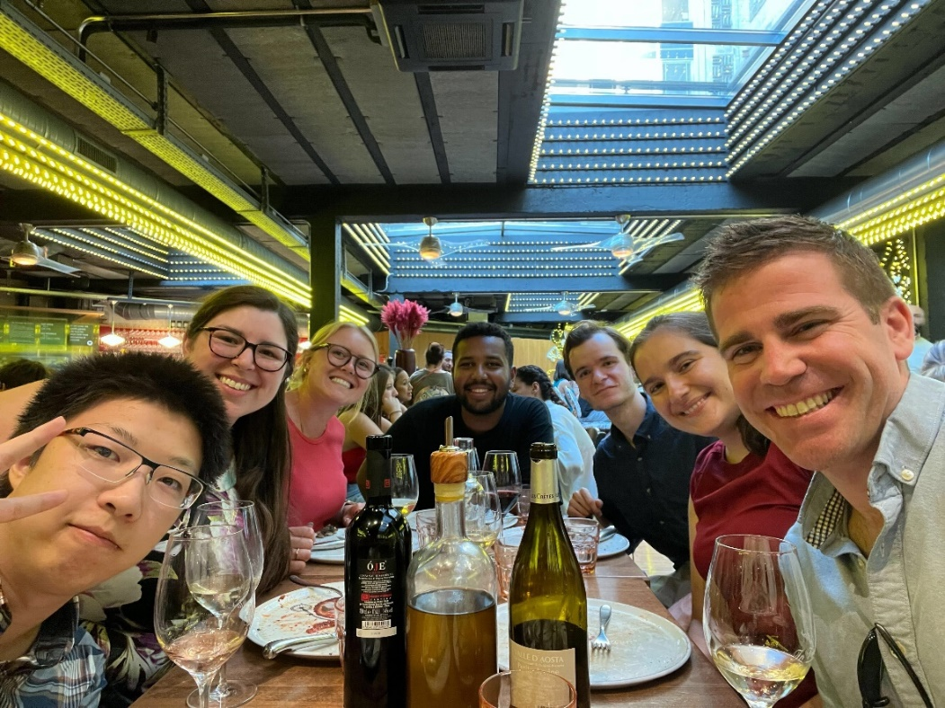
7. Life
Old CIS techs leaving
Katie left on July 25
Dawit left on August 13
Prof. David Miller’s visit late June
Getting settled in the city
Learning/refreshing driving manual
June 29th , Dinner at Luigi’s

Slide 19
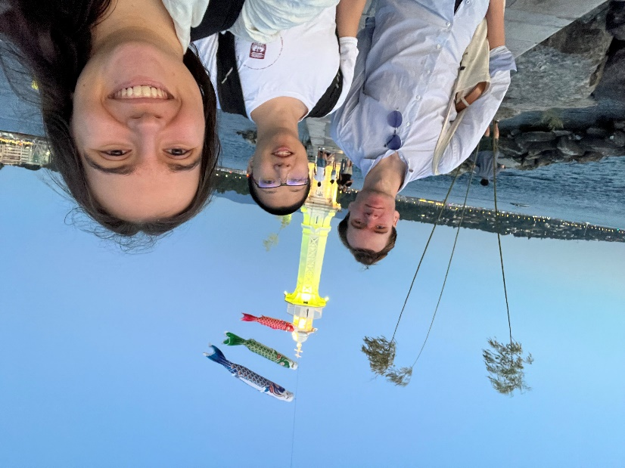
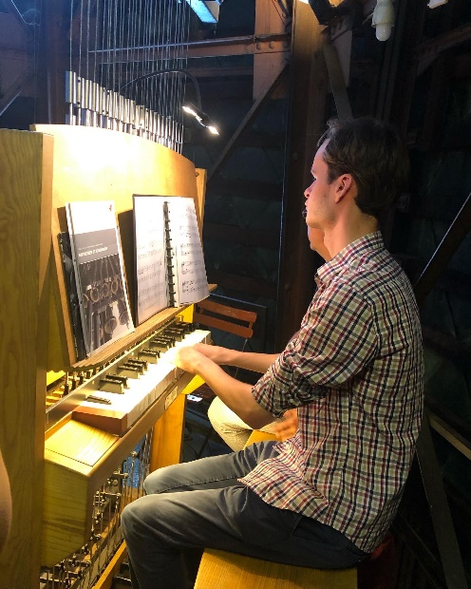
7. Life (More Pictures)
Jacky teaching Peter to drive manual
Peter playing the carillon at Cathedrale St.-Pierre
At Bains de Pâquis

Slide 20
8. Questions
Add questions here if we have any

Slide 21
Thank you for your attention ☺

